Slide 1
Blocking & Hallucination Treatment Investigation
Dong Zhang CCRS Government of Canada December 8, 2025

Slide 2
Blocking Treatment Methodology
The small blocking throughout the predictions are assumed to be caused by the 4x4 pixel window in the PVT model
We counteract this by overlapping and averaging between the windows:
Generate four offset minicubes by shifting the center coordinate north/south and then east/west by 2 pixels (40 meters) each
Run the prediction model for the original and the offset minicubes
Align overlapping offset pixels with the center minicube to average NDVI values

Slide 3
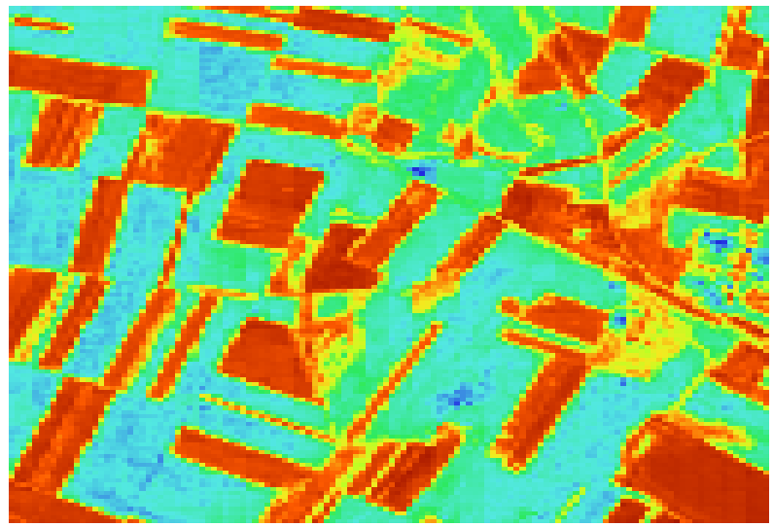
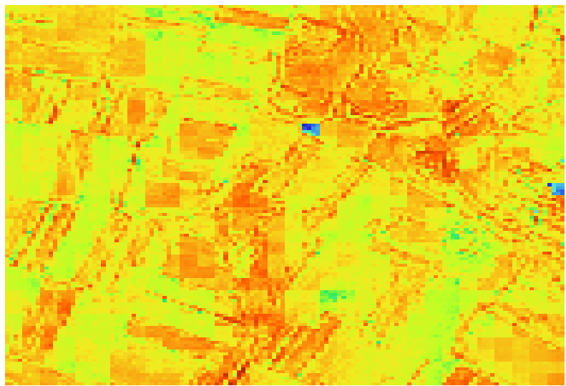
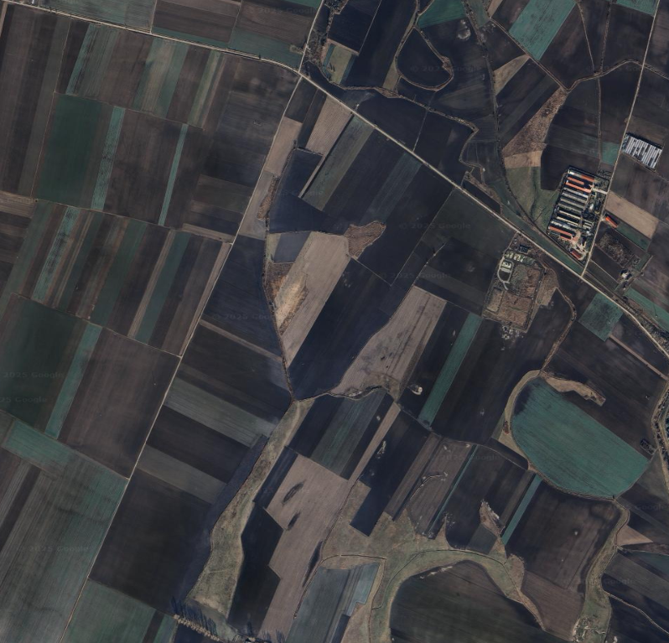
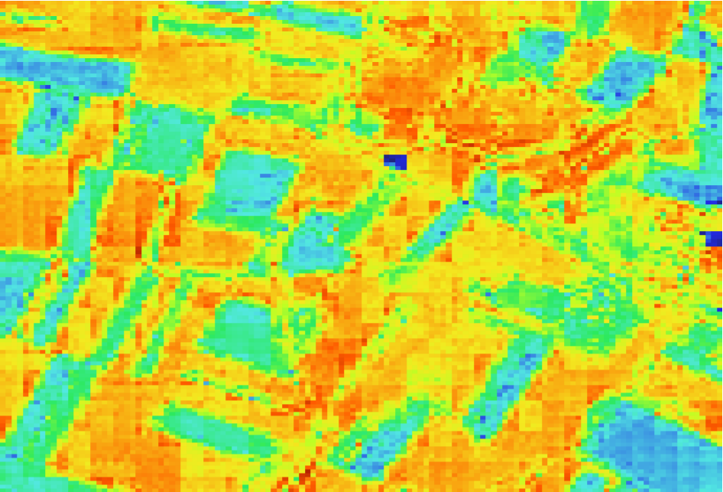
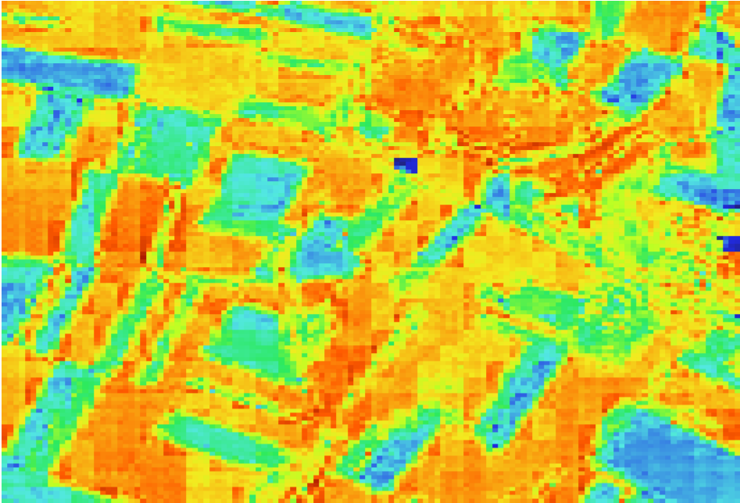
Site 225 MJJ21
Timestep 5
Timestep 10
Original Results
Timestep 15
Timestep 20

Slide 4
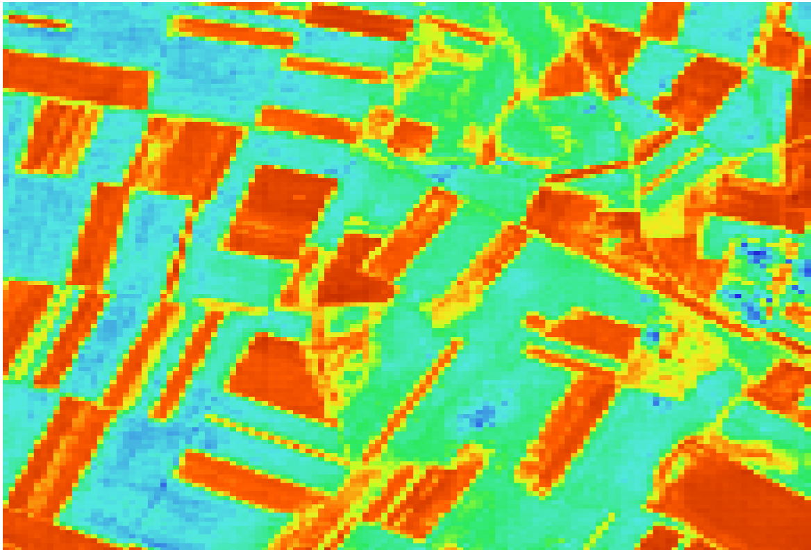
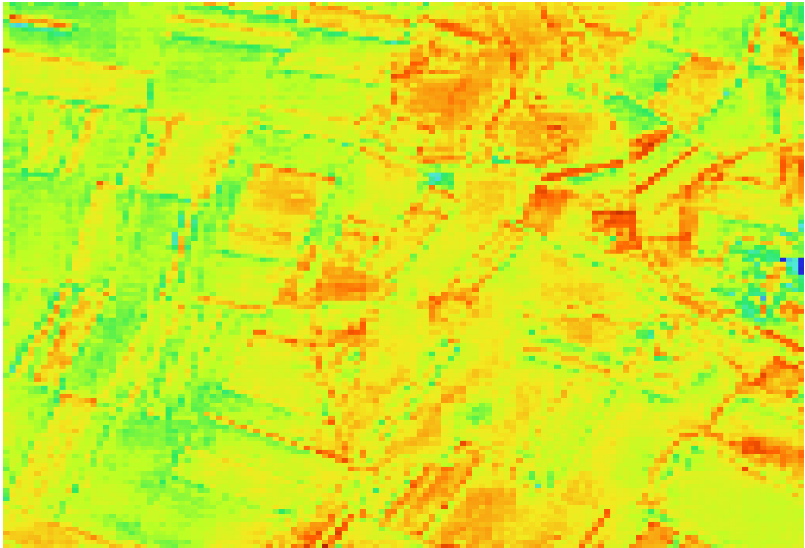
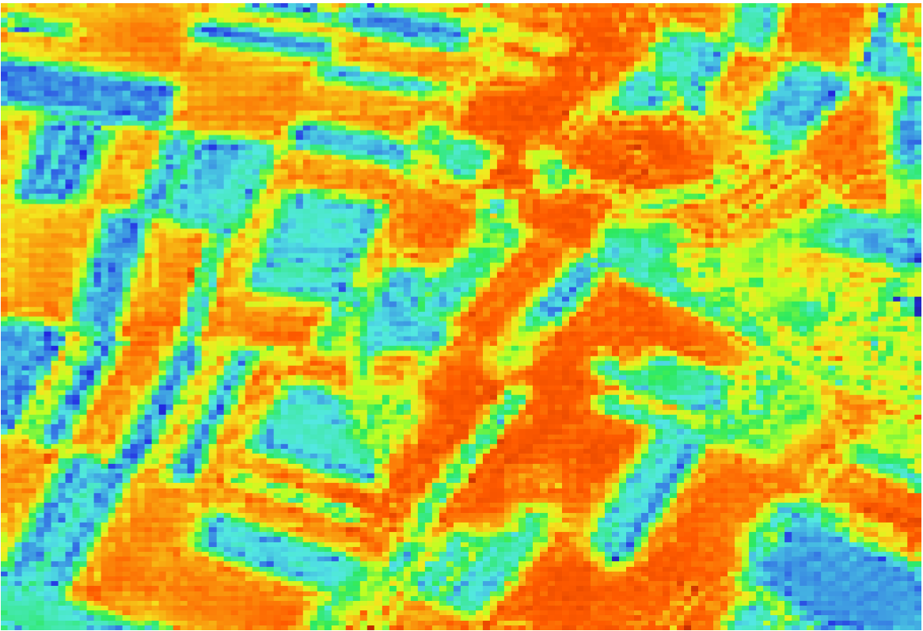
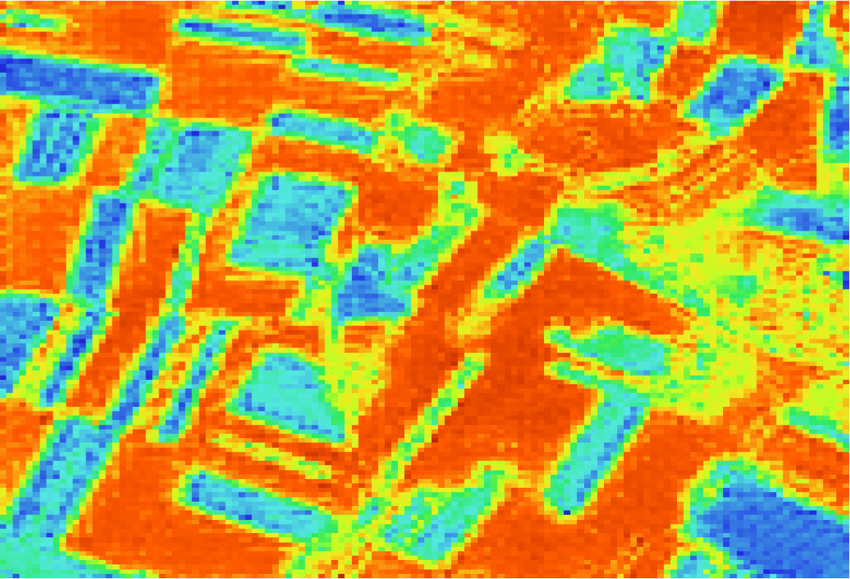
Site 225 MJJ21
Timestep 5
Timestep 10
Treatment Results
Timestep 15
Timestep 20

Slide 5
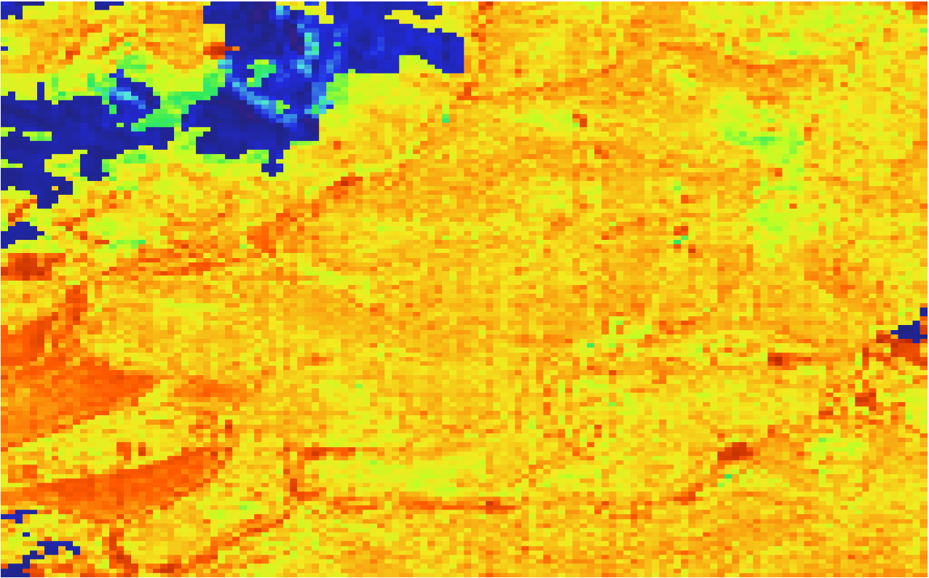
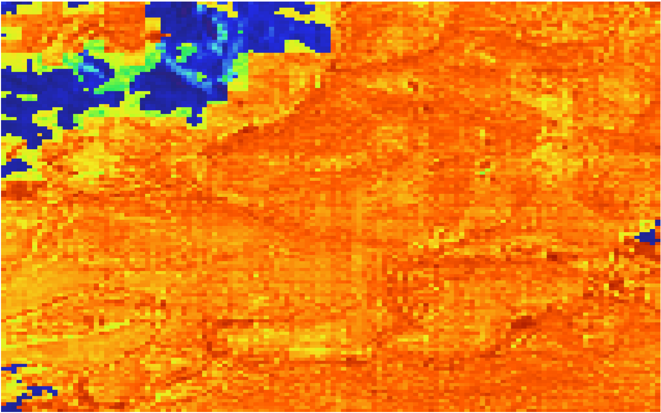
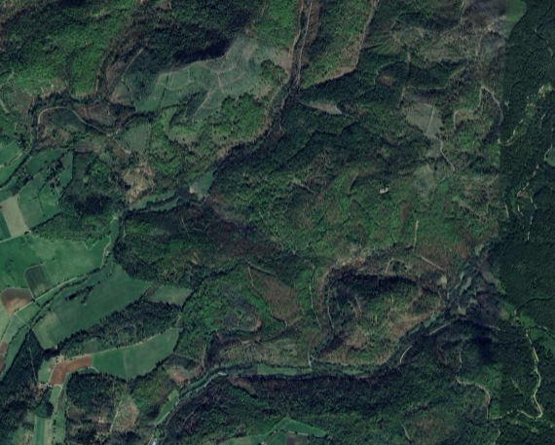
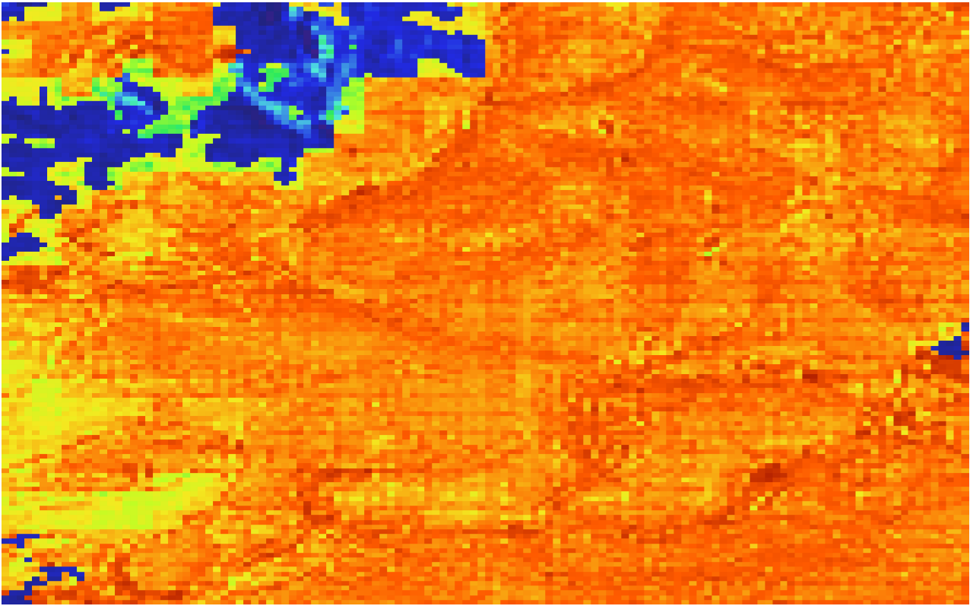
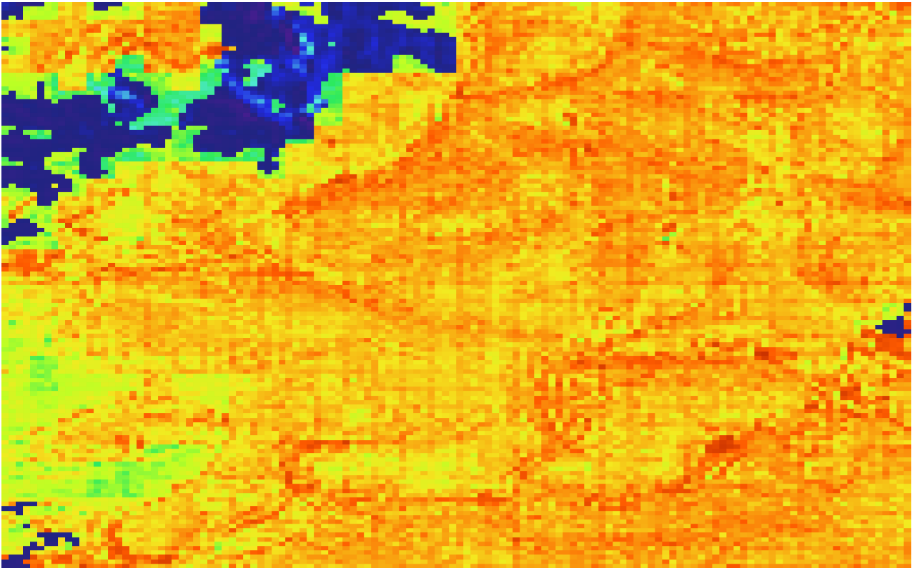
Site 120 MJJ21
Timestep 5
Timestep 10
Original Results
Timestep 15
Timestep 20

Slide 6
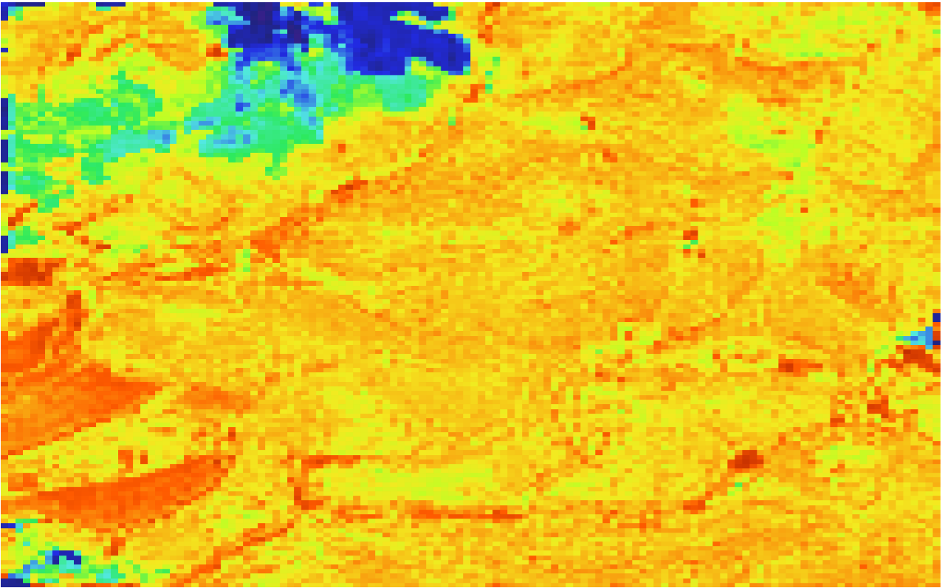
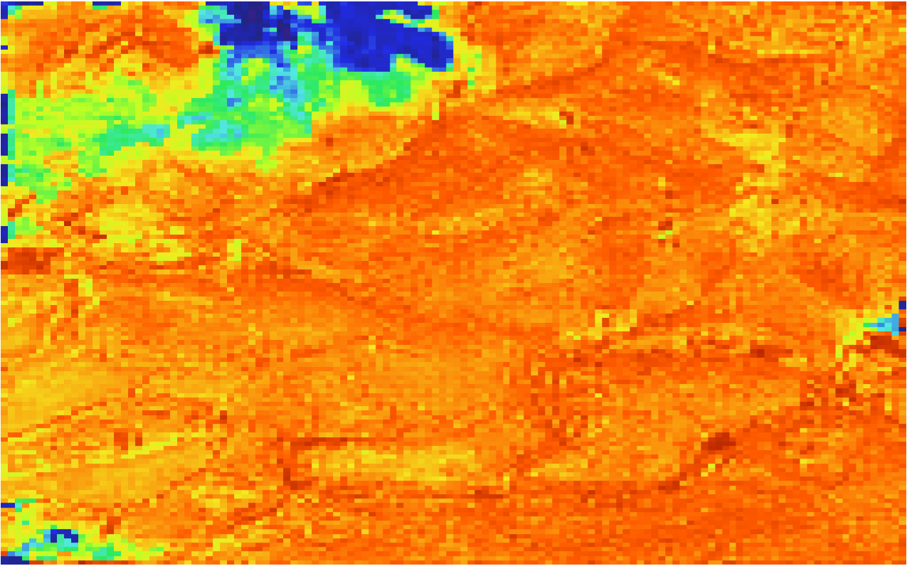
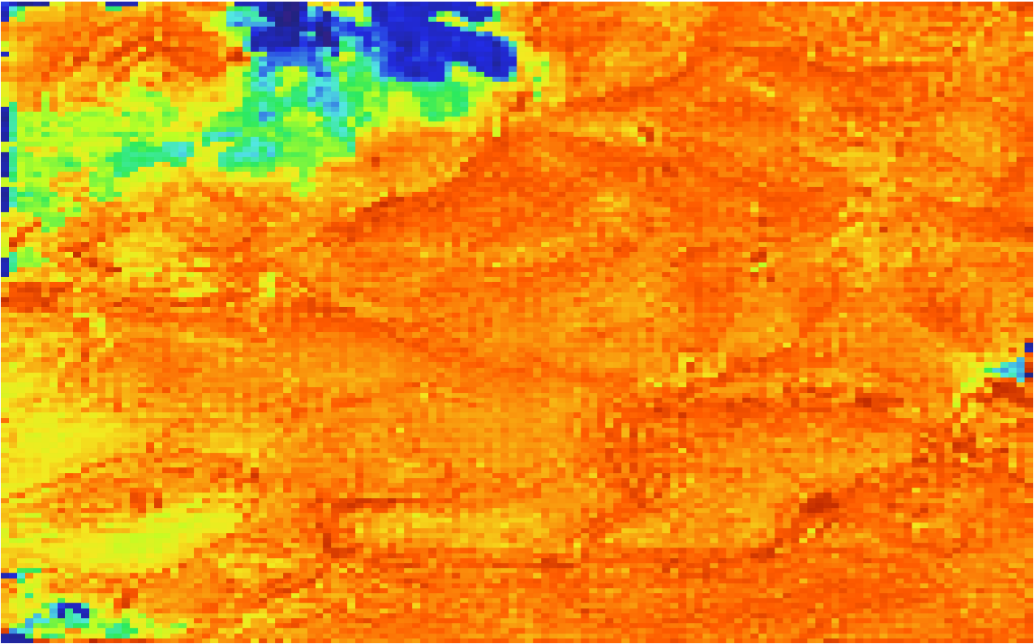
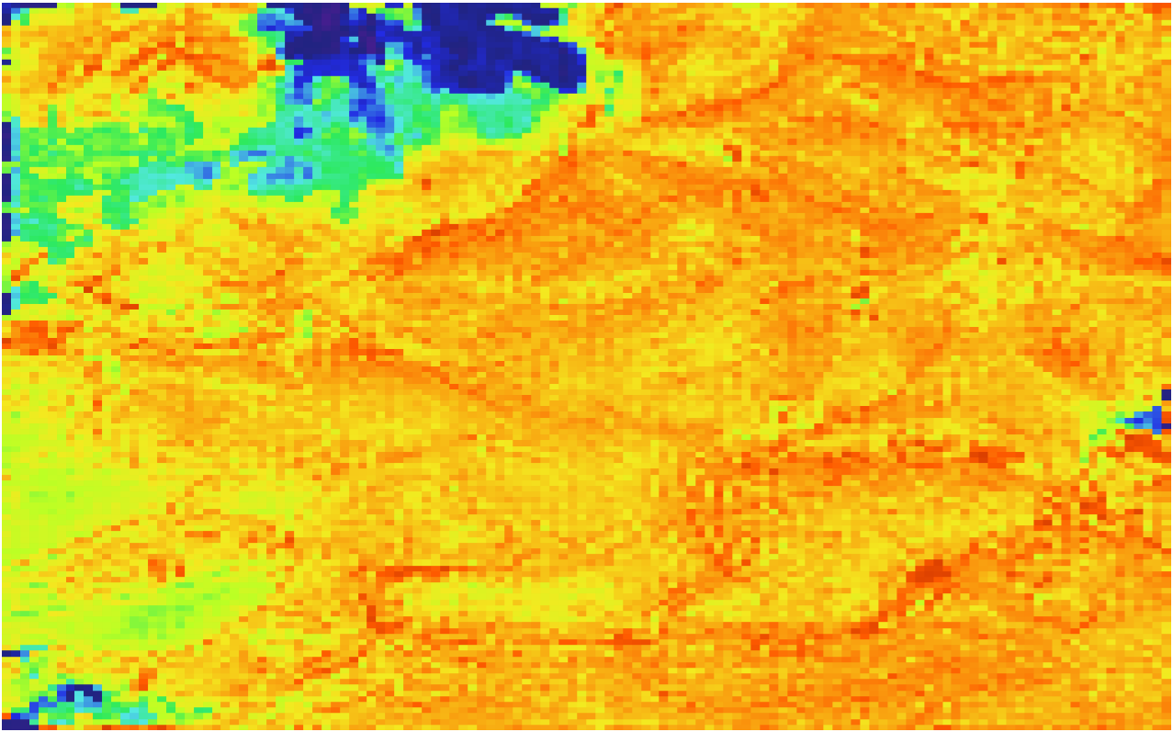
Site 120 MJJ21
Timestep 5
Timestep 10
Treatment Results
Timestep 15
Timestep 20

Slide 7
Hallucination Treatment Methodology
Using ESA Worldcover data, minicubes are grouped into 3 categories based on the majority pixel count:
crop dominated
forest dominated
shrub/grassland dominated
In each category, the minicubes remain sorted by their Sentinel 2 / MGRS tile
The model is trained on all the minicubes of a specific category and tile for a “site specific” retraining treatment
The hallucination issue is mostly with crop sites, however a forest and a shrub site are included to demonstrate the effect of this retraining

Slide 8
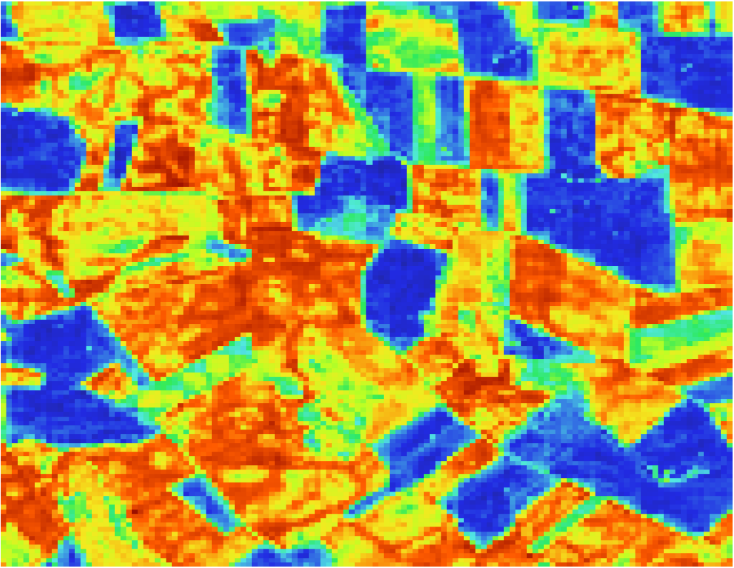
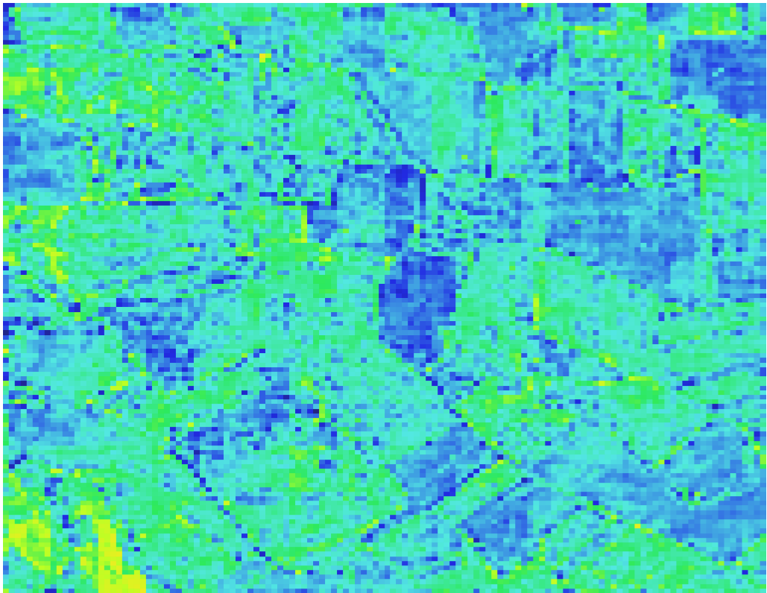
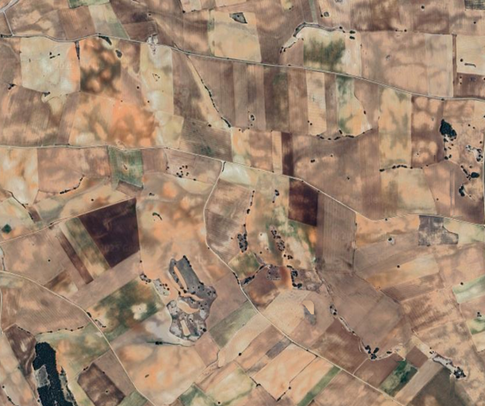
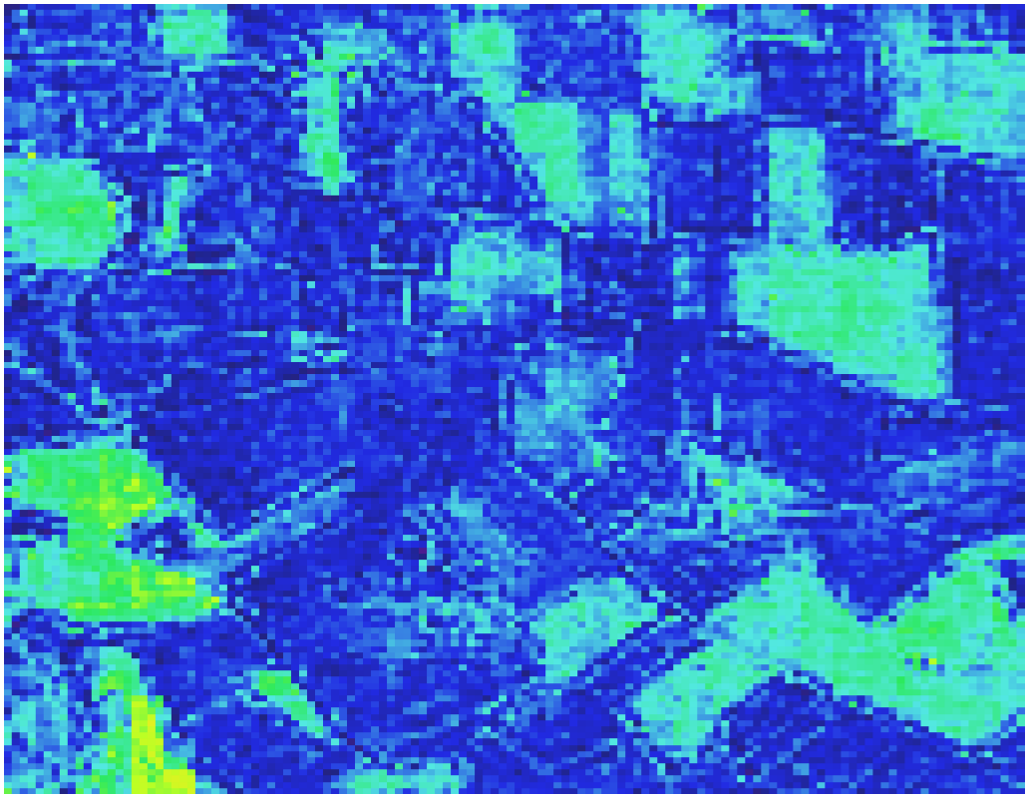
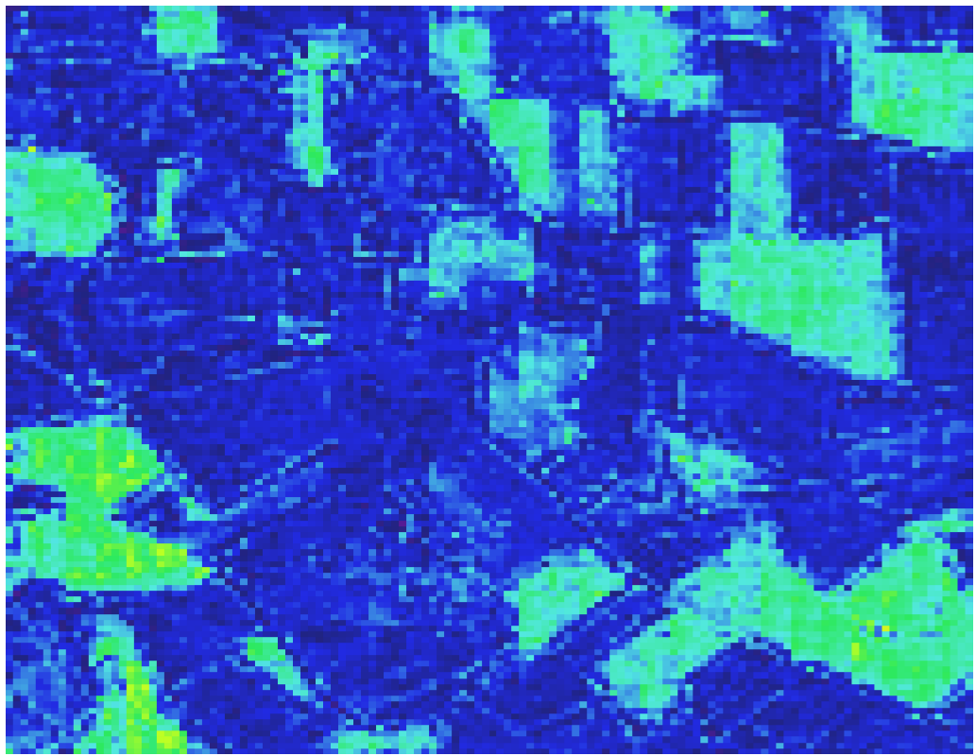
Site 27 MJJ21
Timestep 4
Timestep 10
Original Results
Timestep 15
Timestep 20

Slide 9
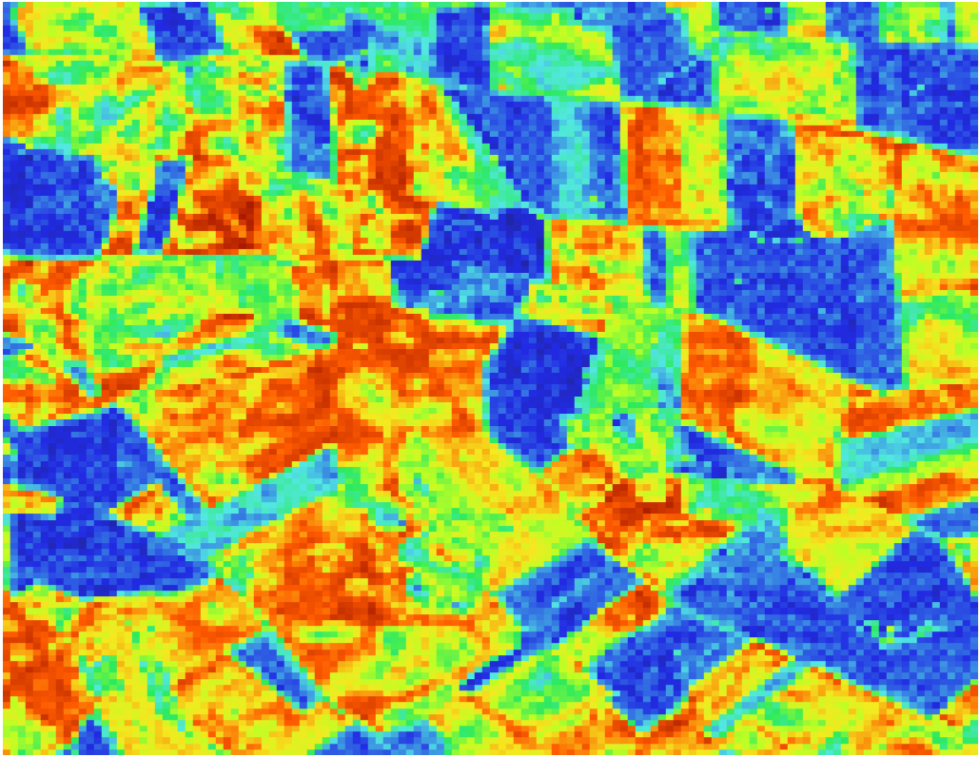
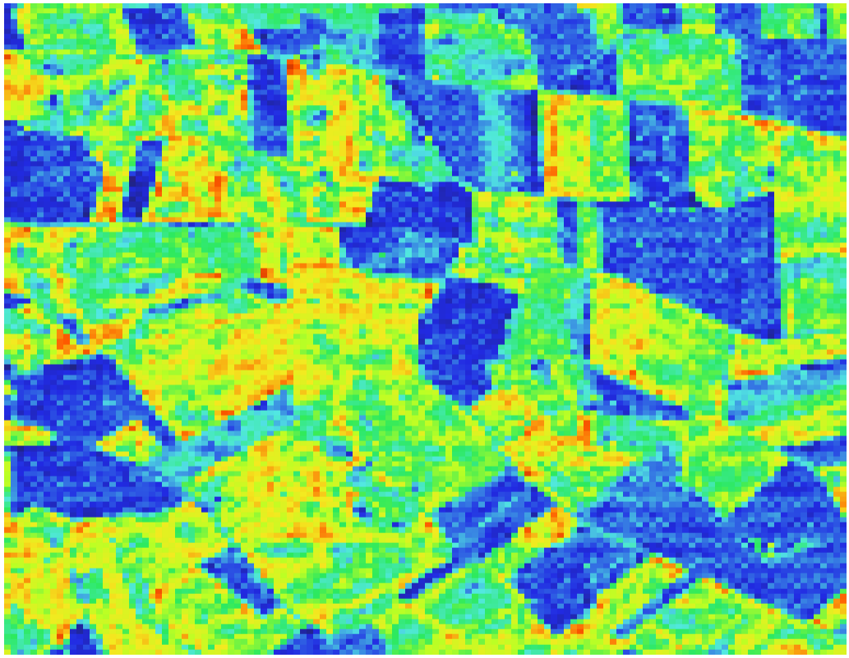
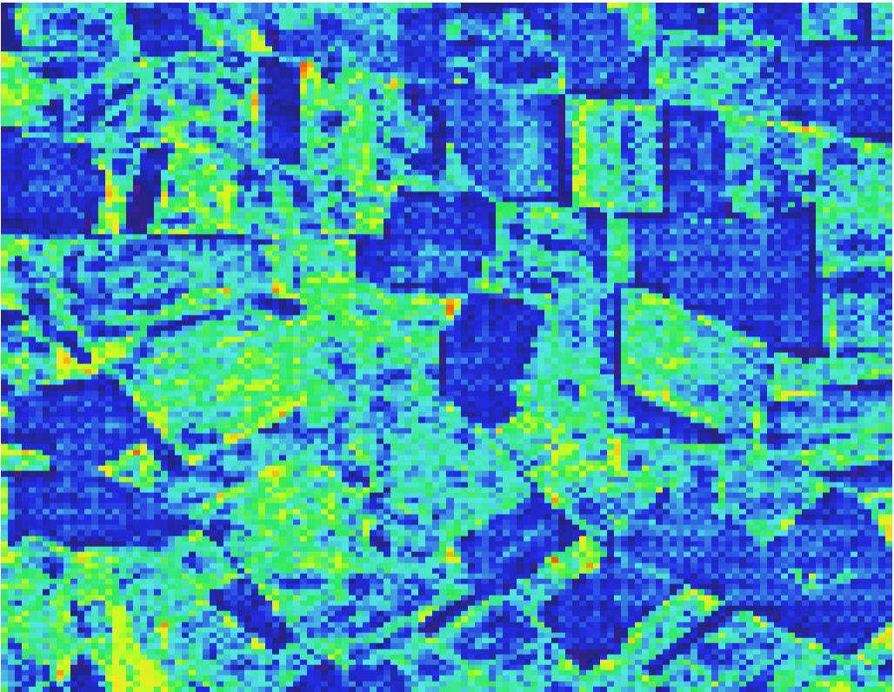
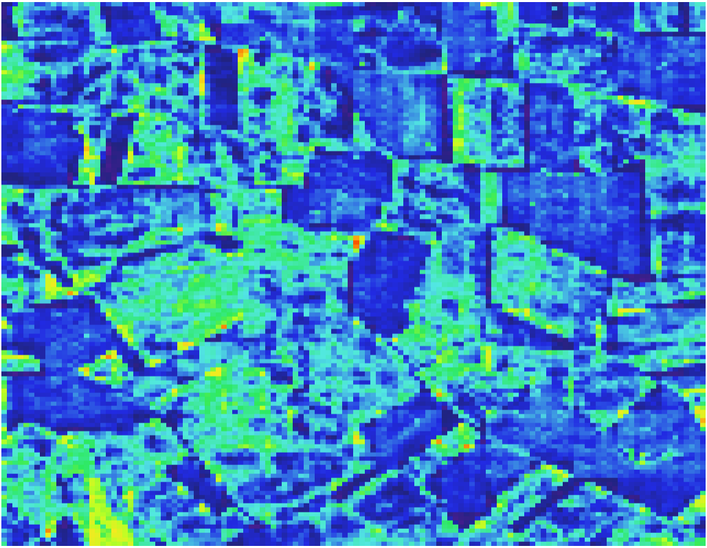
Site 27 MJJ21
Timestep 4
Timestep 10
Retrained
Results
(226 minicubes)
Timestep 15
Timestep 20

Slide 10
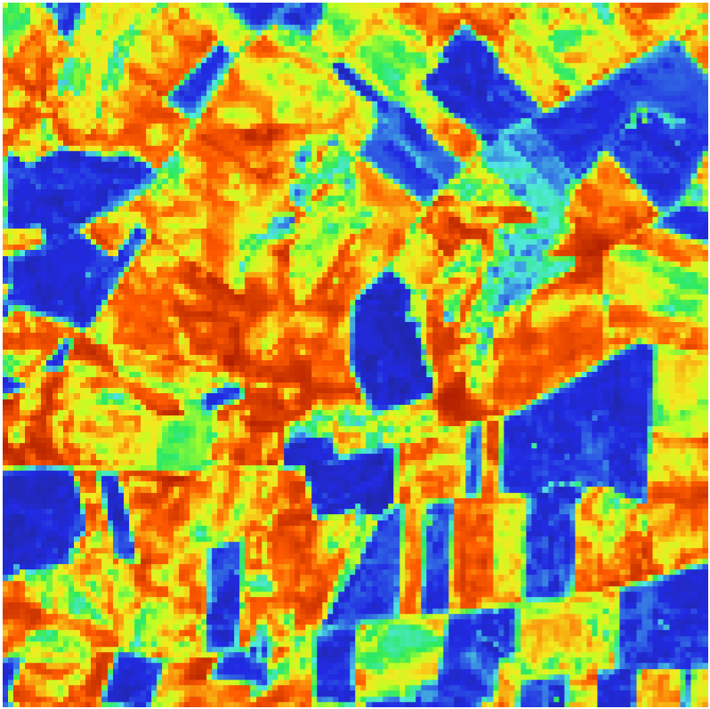
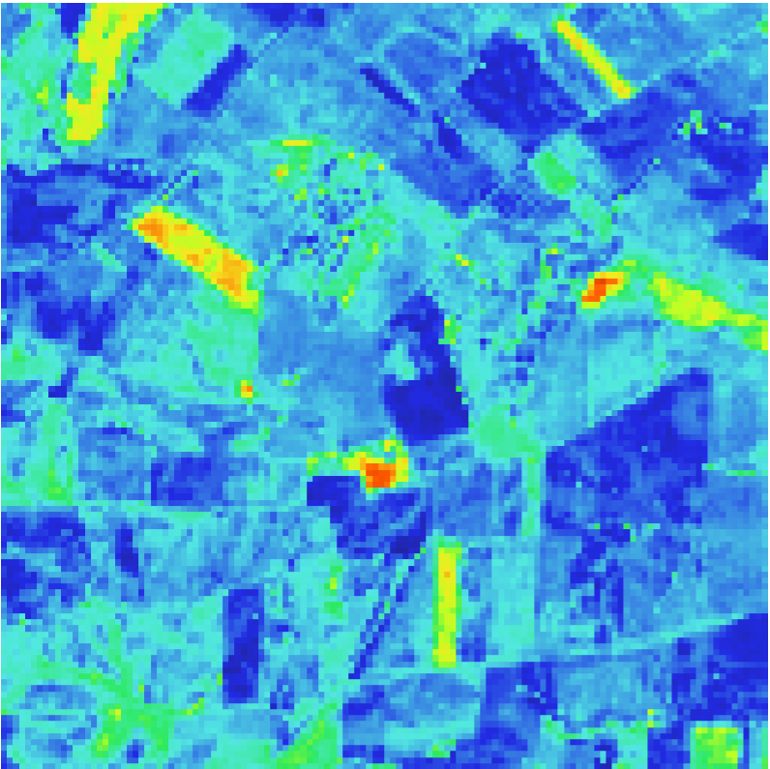
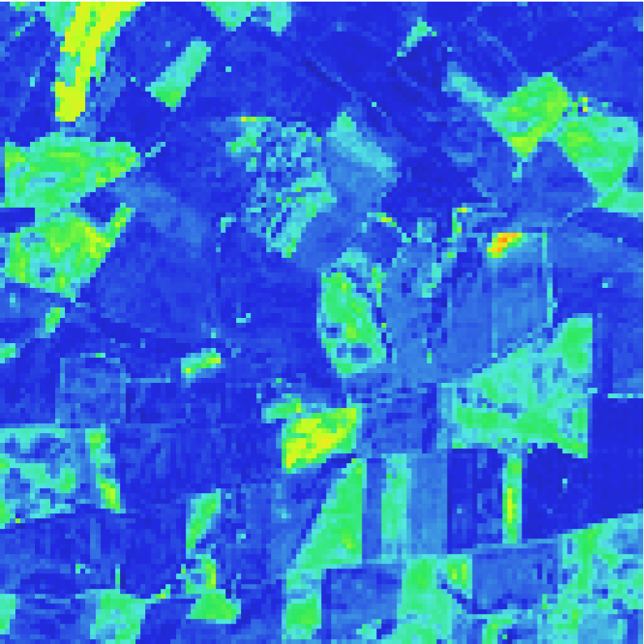
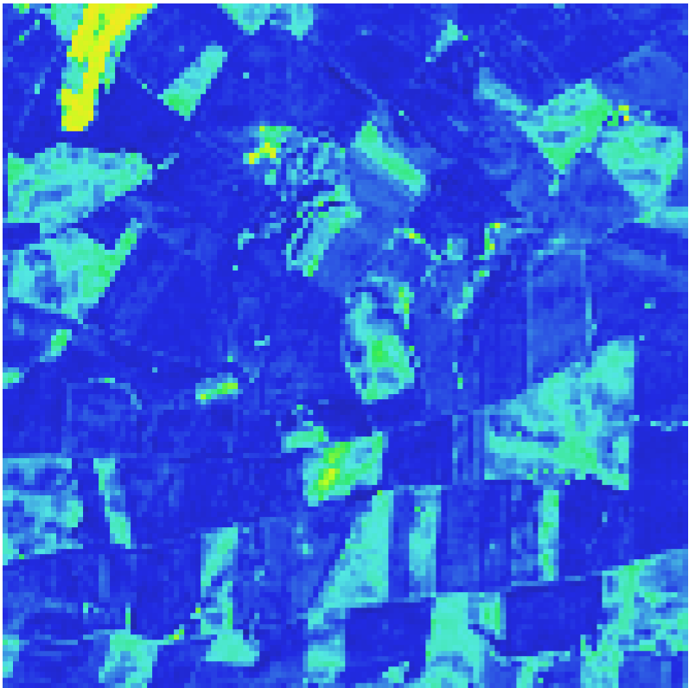
Site 27 MJJ21
Timestep 4
Timestep 9
Minicube NDVI
Timestep 15
Timestep 20

Slide 11
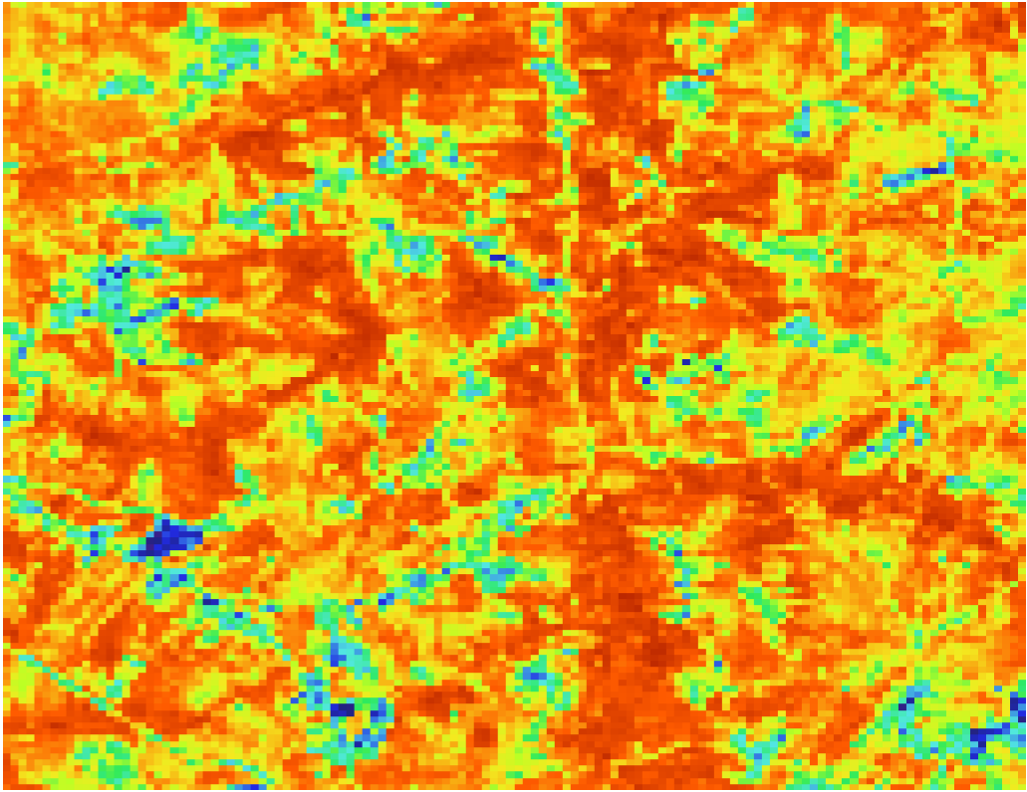
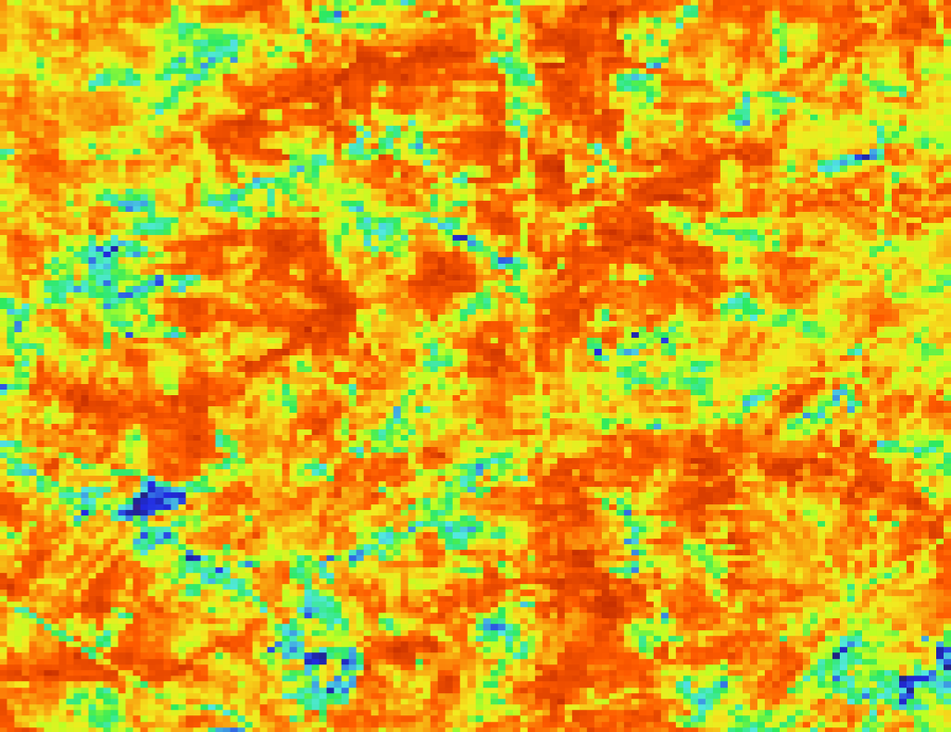
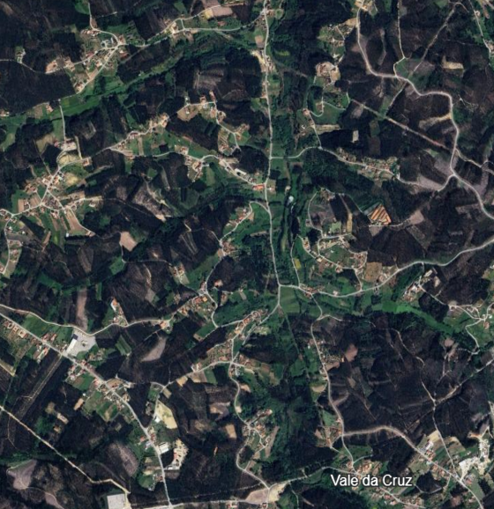
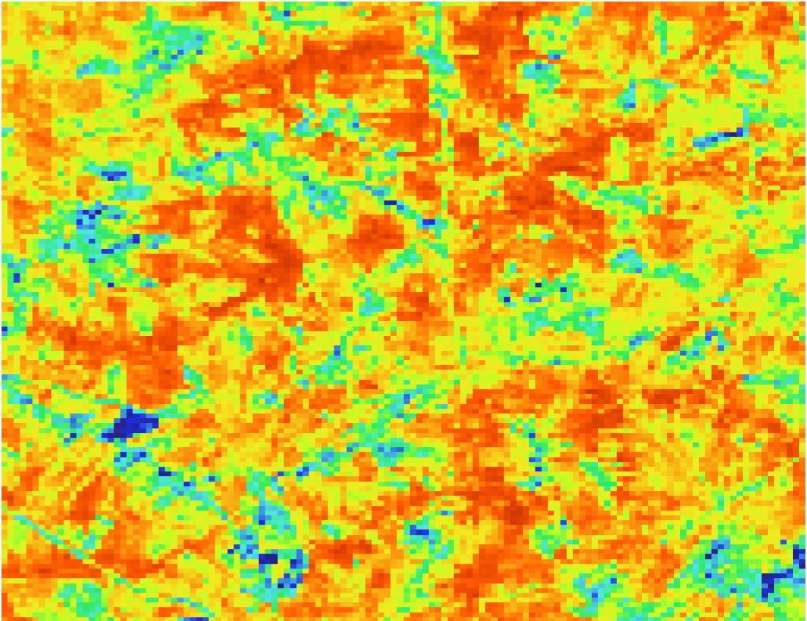
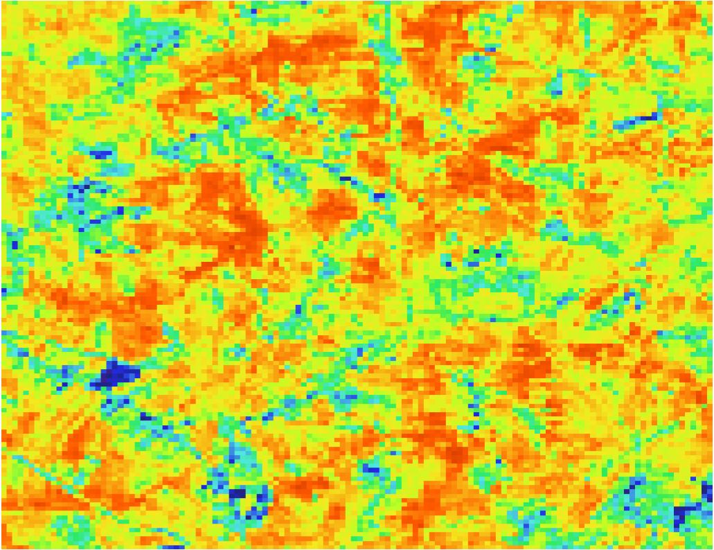
Site 11 MJJ21
Timestep 4
Timestep 11
Original Results
Timestep 15
Timestep 18

Slide 12
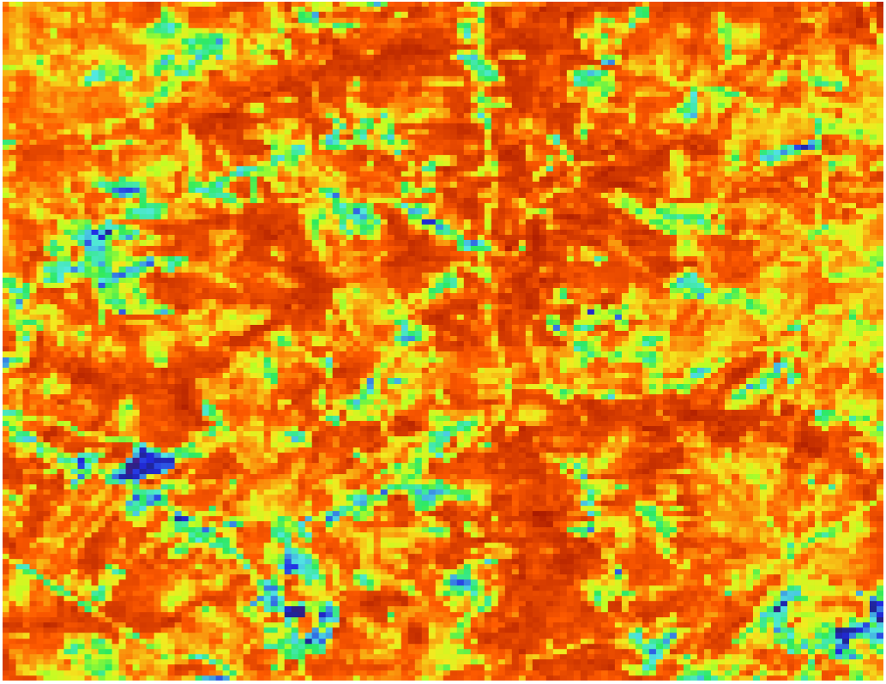
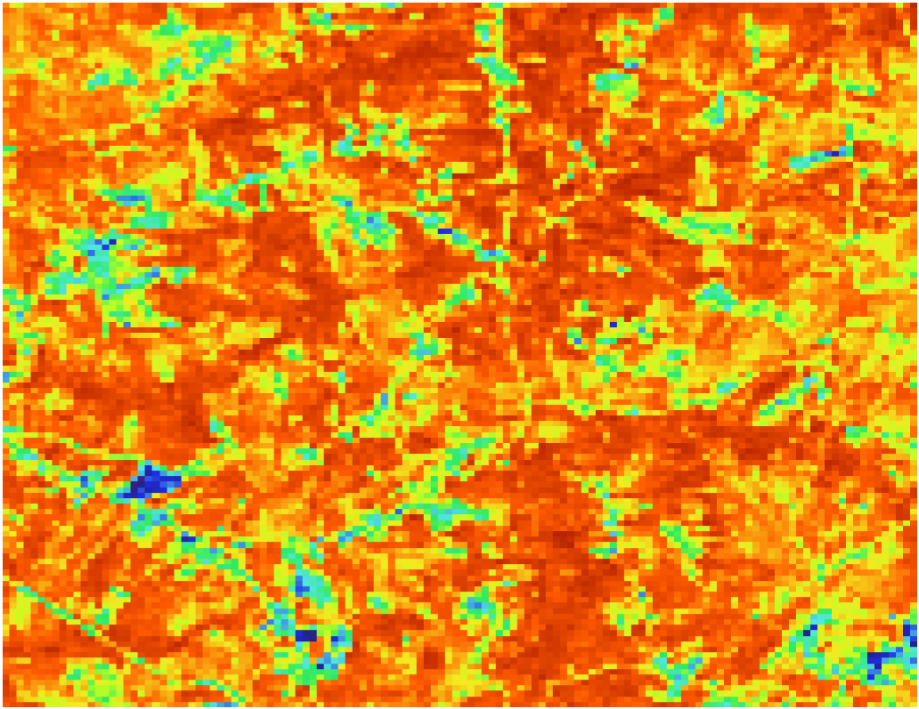
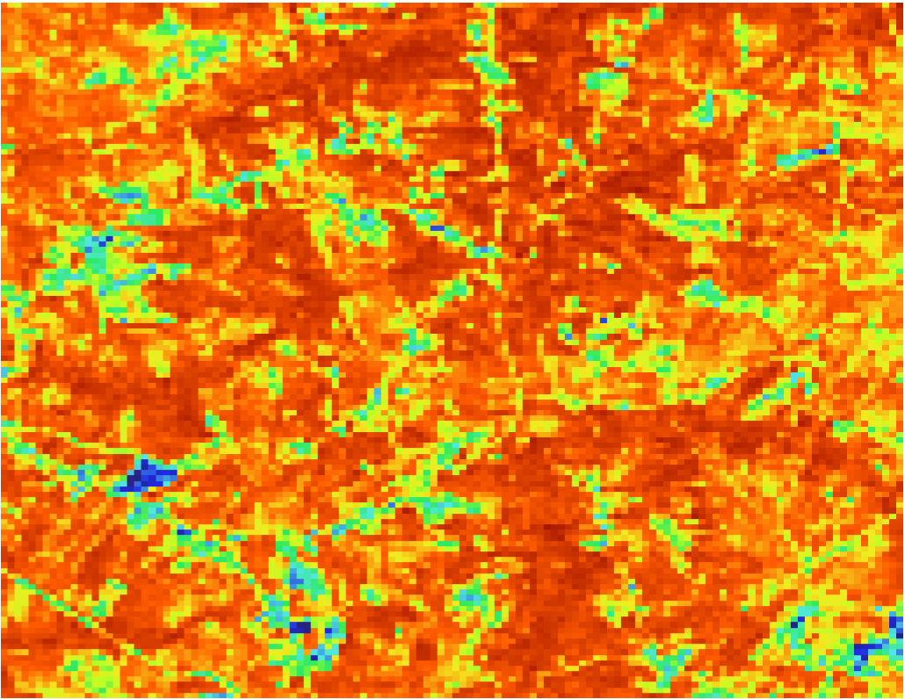
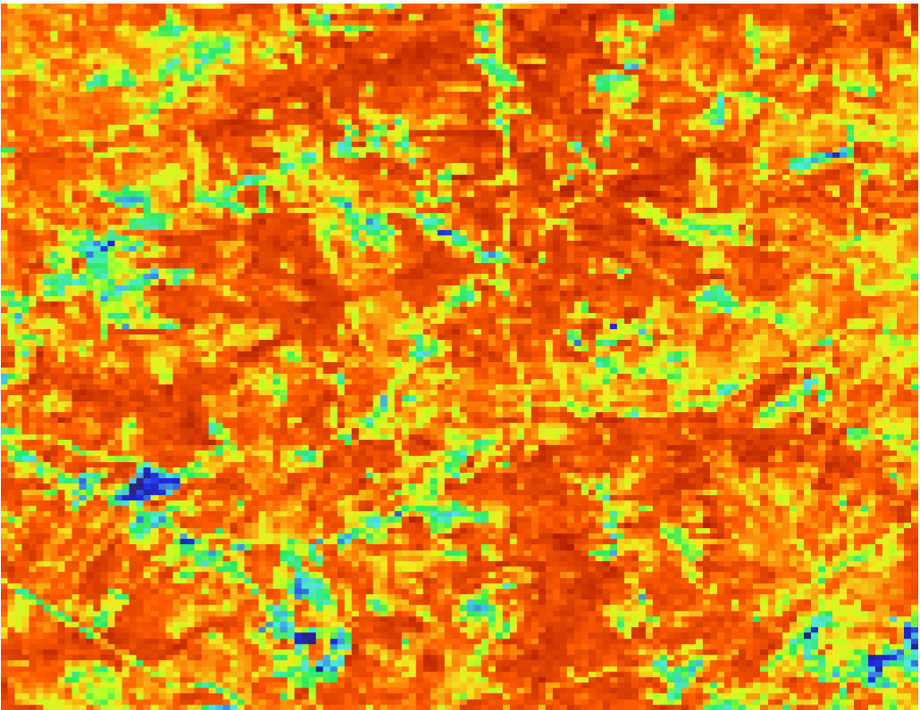
Site 11 MJJ21
Timestep 4
Timestep 11
Retrained Results
(654 minicubes)
Timestep 15
Timestep 18

Slide 13
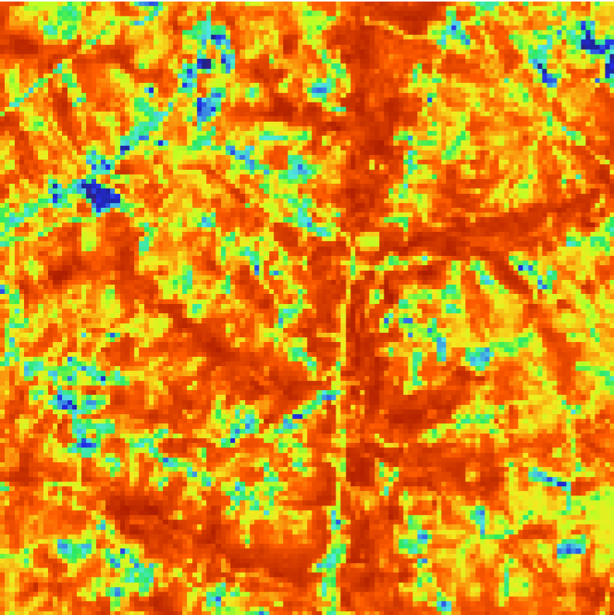
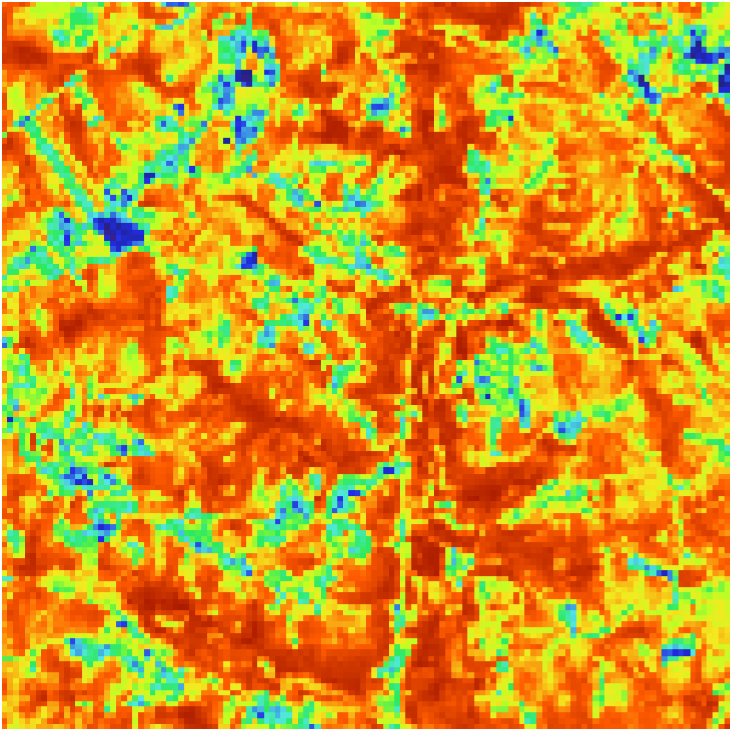
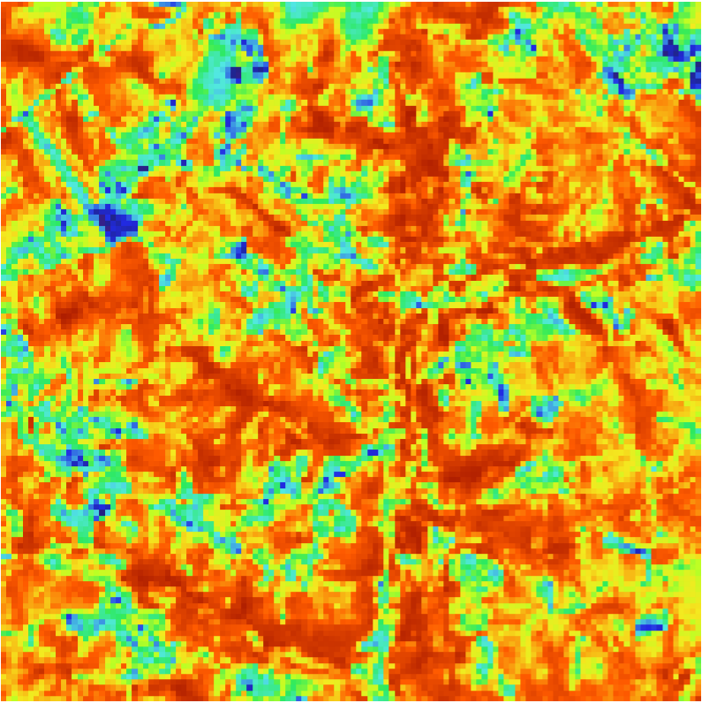
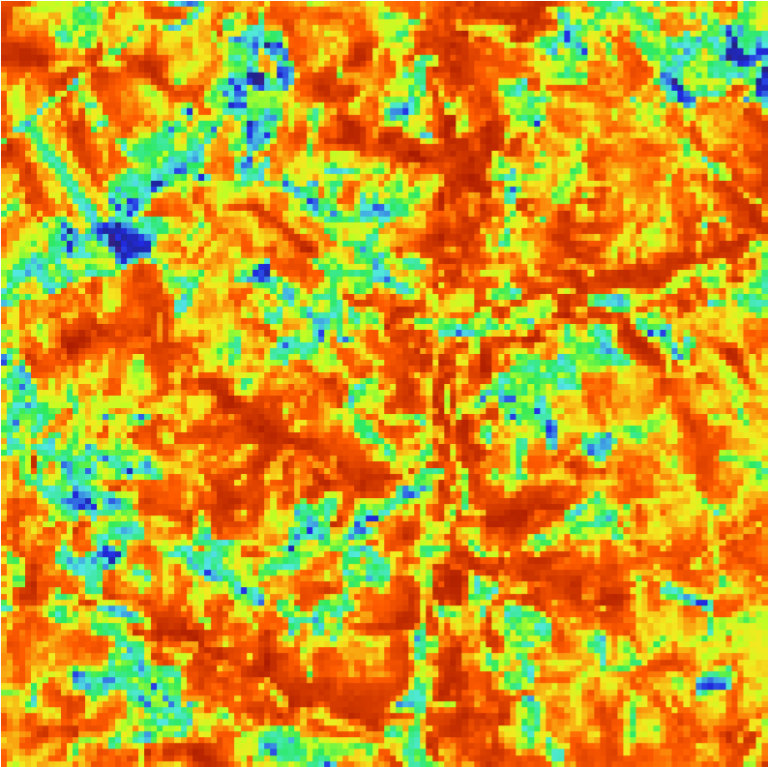
Site 11 MJJ21
Timestep 4
Timestep 11
Minicube NDVI
Timestep 15
Timestep 18

Slide 14
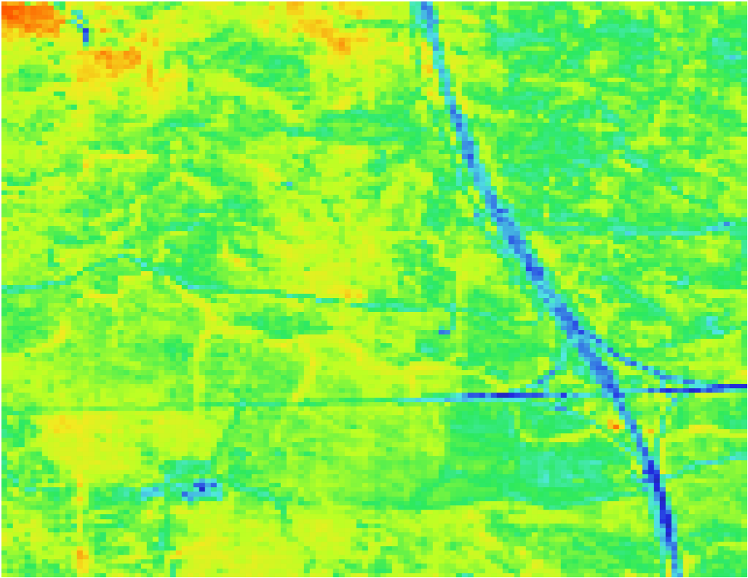
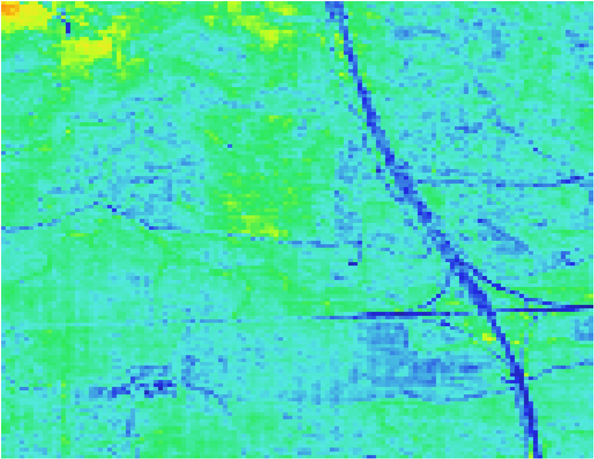
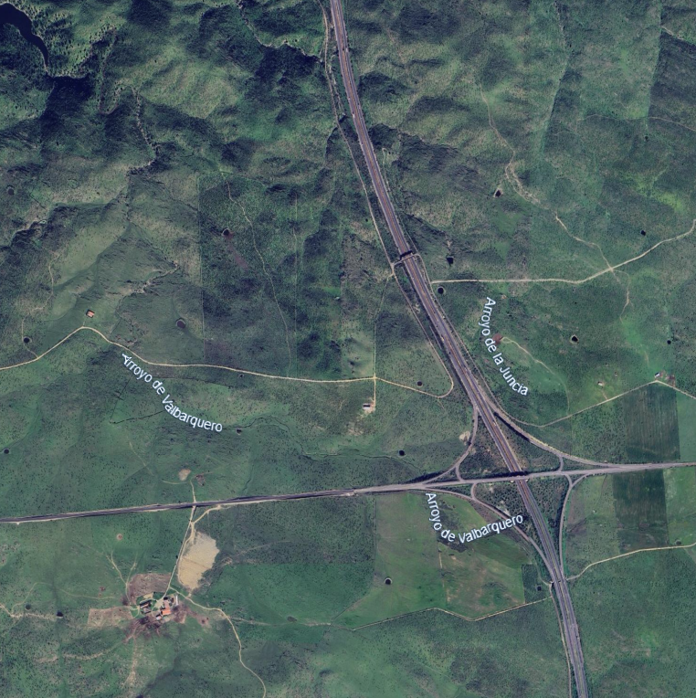
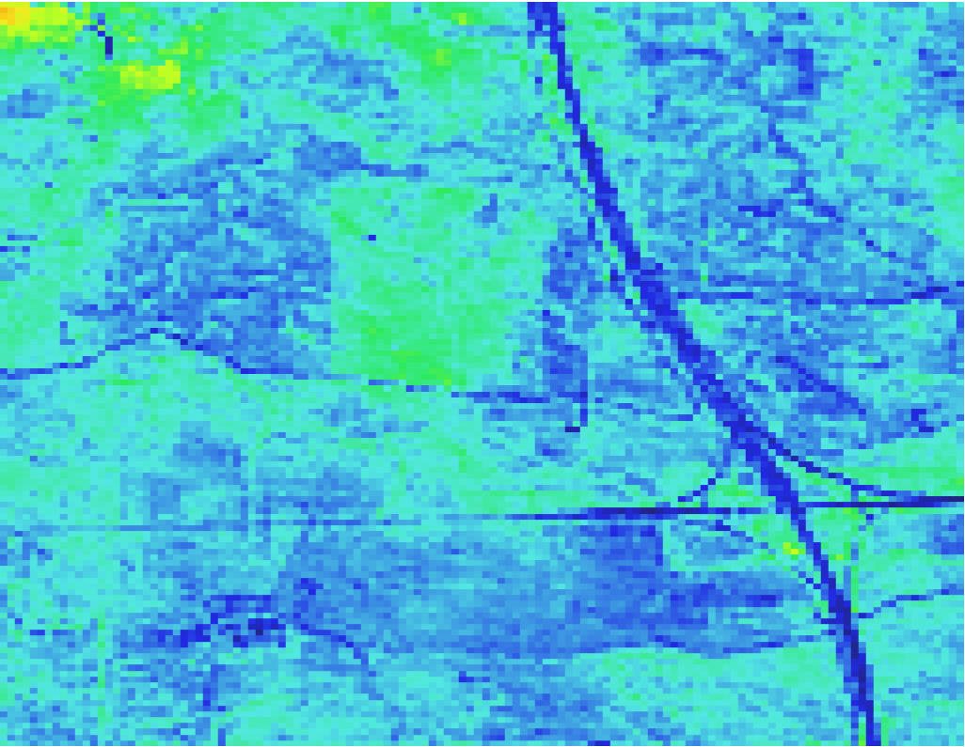
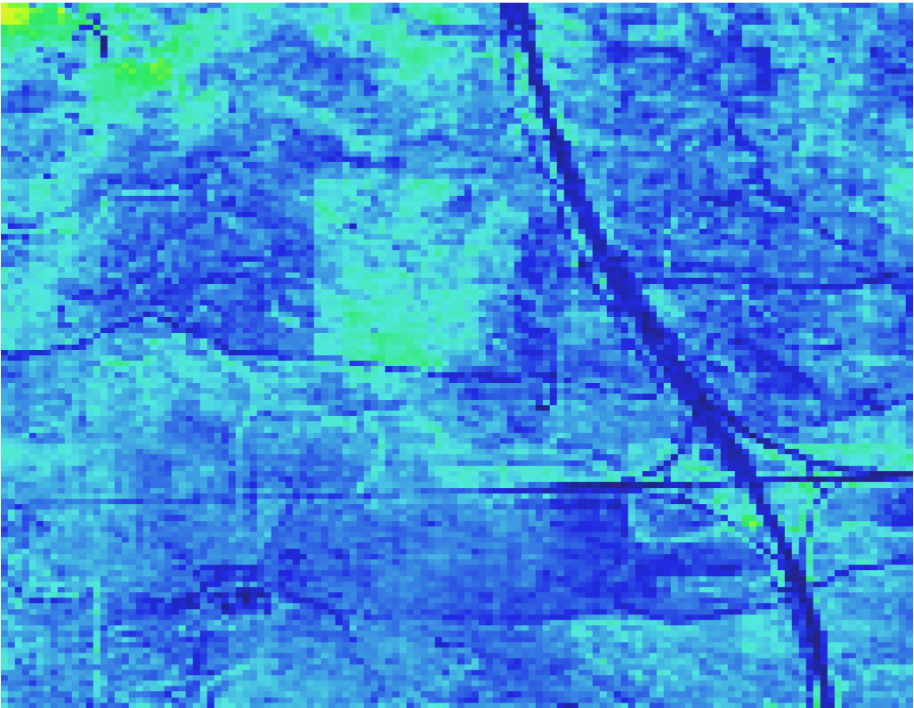
Site 26 MJJ21
Timestep 4
Timestep 9
Original Results
Timestep 15
Timestep 20

Slide 15
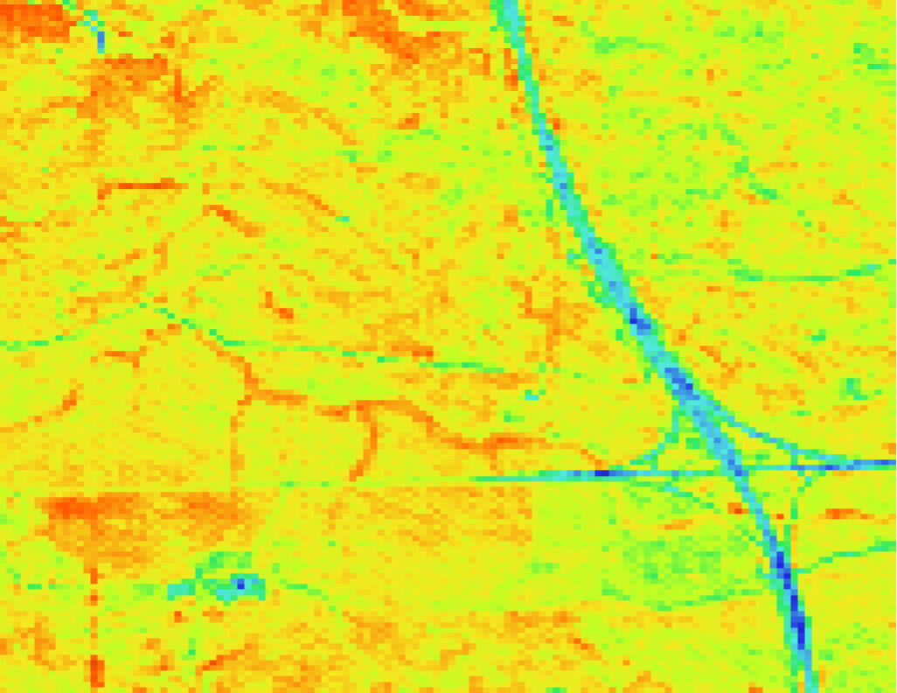



Site 26 MJJ21
Timestep 4
Timestep 9
Retrained Results
(762 minicubes)
Timestep 15
Timestep 20

Slide 16




Site 26 MJJ21
Timestep 4
Timestep 9
Minicube NDVI
Timestep 15
Timestep 20

